Slide 1
<未定>
D04944017 陳瑜 , R04922118 王若芸 , R04922090 蕭博文

Slide 2
Goal
吸引行人注意力
延長有緣人駐足時間（分散他想離開的注意力）
免整型膚質改善作業

Slide 3
Method
Face detect (Open source)
Age and gender detect (API from Microsoft)
Skin detect (reference from web)
Skin color smooth (blur, mask…)

Slide 4
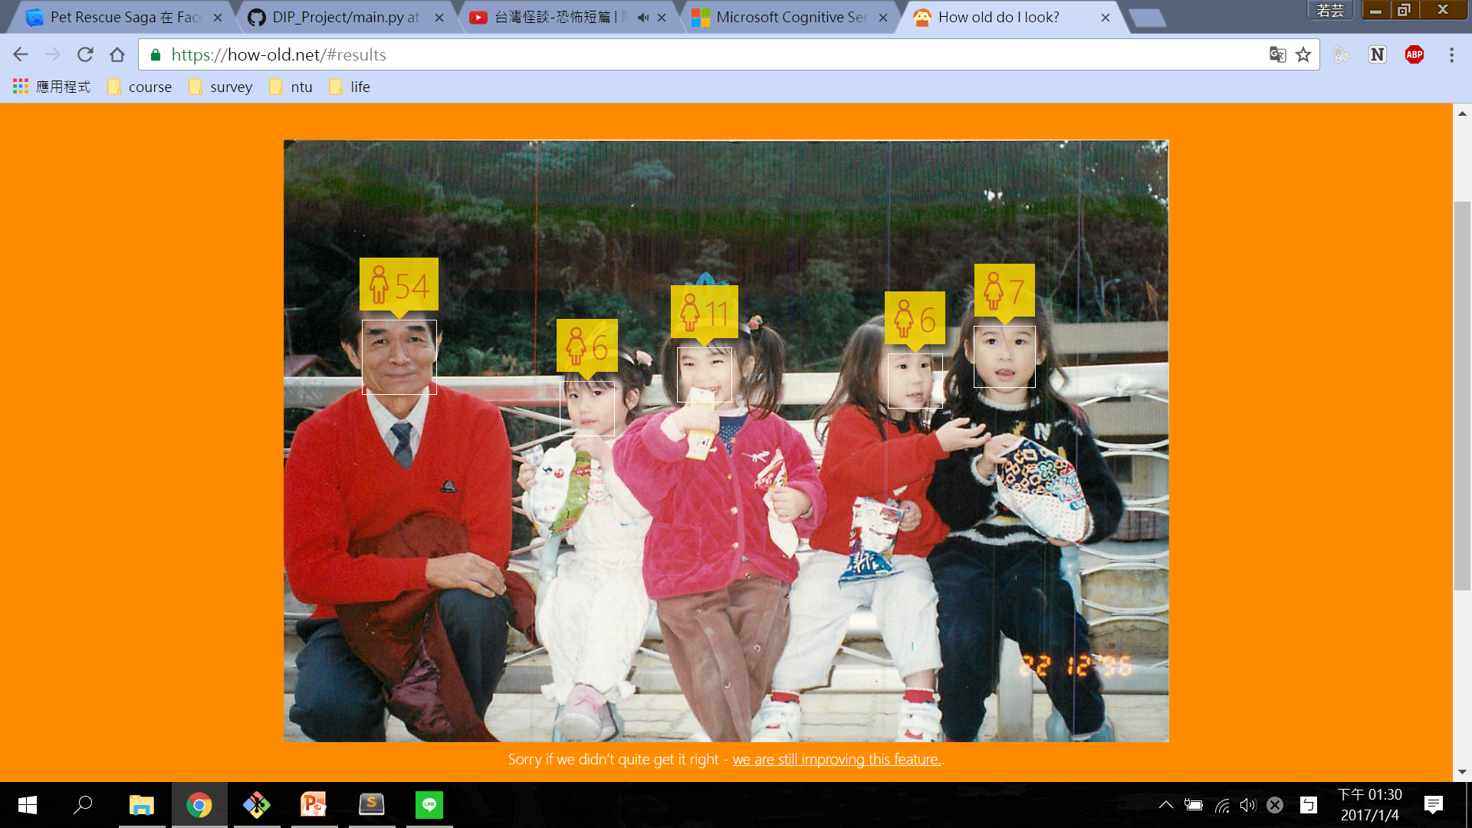
Age and gender Detect
Capture frame from camera
Cogntive_face API
Get the depiction of frame
Extract age & gender from JsonFormat
Show NPC based on your age& gender
[{u'faceRectangle': {u'width': 234, u'top': 265, u'height': 214, u'left': 223},
u'faceAttributes': {u'gender': 'female', u'age': 22.7}}]

Slide 5
Skin detect and color smooth
Skin detect
Smooth
Convert to HSV space
Set upper and lower bound for skin color
Erode + Dilation + GaussianBlur
get
Skin Mask
get skin image (RGB)
skin image
(RGB)
Blur
Skin image
erode the edge
Max(skin, frame)
Gamma correction
Skin Mask
Goodfeaturetotrack
Track spot on face
Blur the point area
Cover it on face

Slide 6
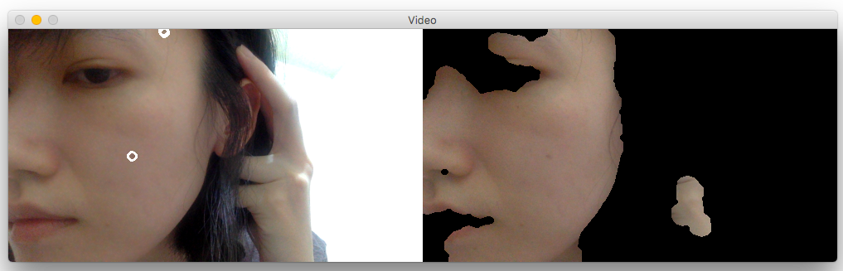

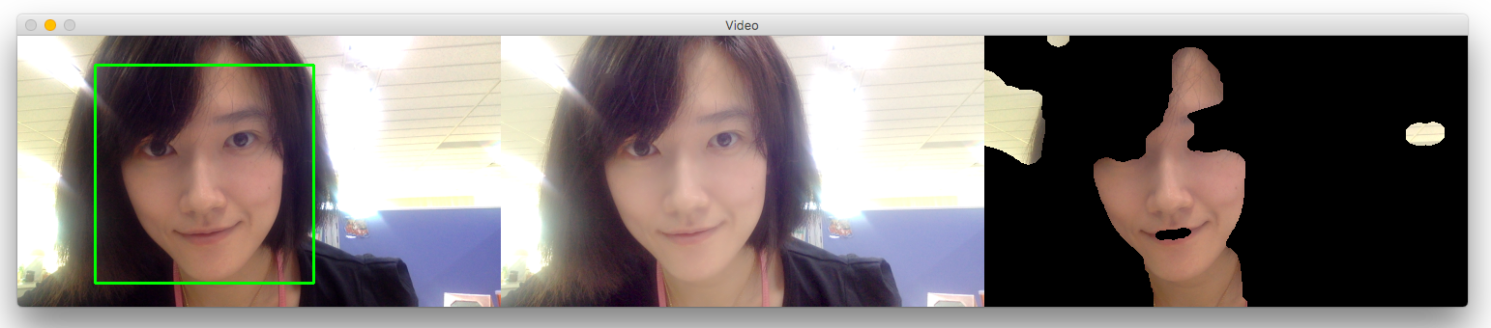

Sample image
原圖
Smooth
Mask

Slide 7
Demo Time

Slide 8
Discussion and Future work
Discussion…
Skin detect not very stable.
GoodFeaturetoTrack not pretty good…, it’s hard to track mole on face.
Future work
Try other ways to detect skin.
Add other effect…

Slide 9
References
Face Detection using Haar Cascades (http://docs.opencv.org/trunk/d7/d8b/tutorial_py_face_detection.html)
Age and gender detection
(https://www.microsoft.com/cognitive-services/en-us/)
GoodFeatureToTrack OpenCV doc.(http://docs.opencv.org/2.4/modules/imgproc/doc/feature_detection.html)
Skin Detection: A Step-by-Step Example using Python and OpenCV (http://www.pyimagesearch.com/2014/08/18/skin-detection-step-step-example-using-python-opencv/)

